Slide 1
Developing Cross-Platform
Mobile Applications
Team members:
Nguyen Minh Triet
Nguyen Quang Huy
Instructor:
Master Nguyen Van Vuong

Slide 2
Topic: develop a world
Cuisine recipe book app

Slide 3

Reason we chose this topic
During the COVID-19 lockdowns, people found themselves with extra time at home
Many individuals began exploring new hobbies
One of the most activities that emerged was cooking

Slide 4
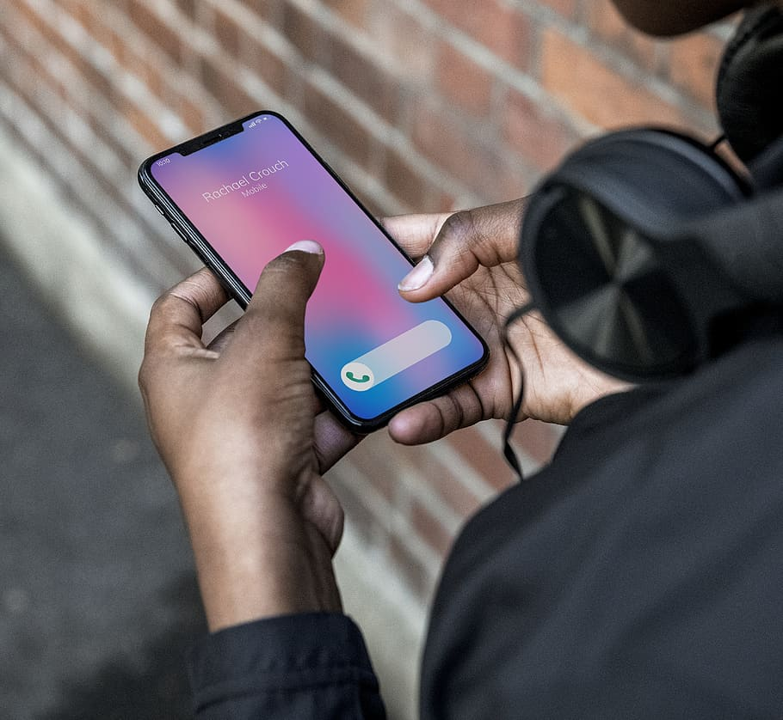
Target user
Chef who’s looking for new recipes to expand their menu
Home-cook or food enthusiasts
Travelers who want to experience the food

Slide 5
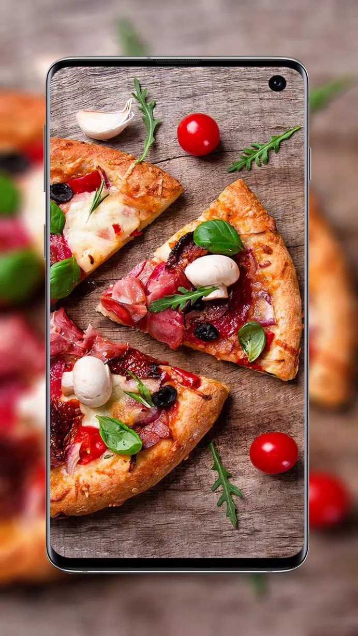
Key Features
Select countries on the map
View recipes
Searching for specific dish using its name or country of origin
Write articles
Edit or delete posts

Slide 6
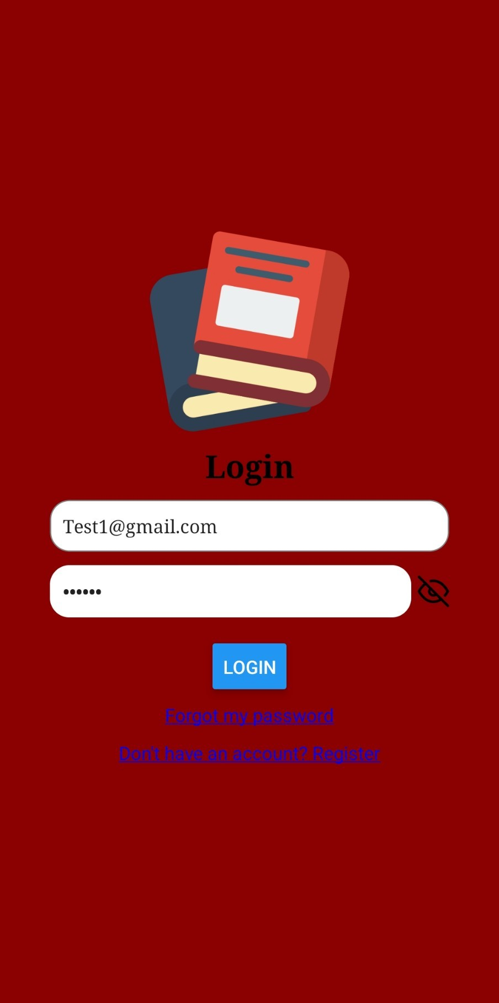
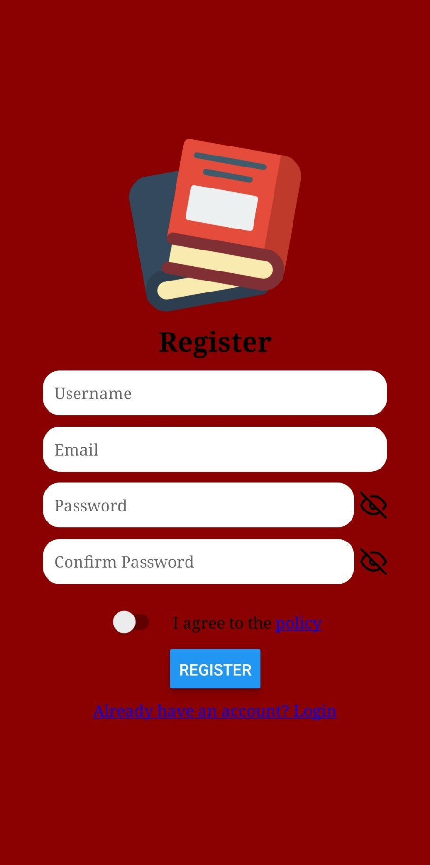
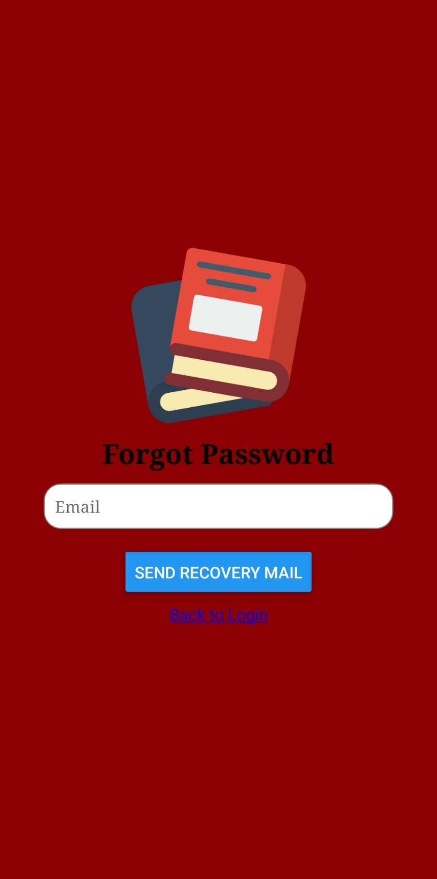
User interface

Slide 7
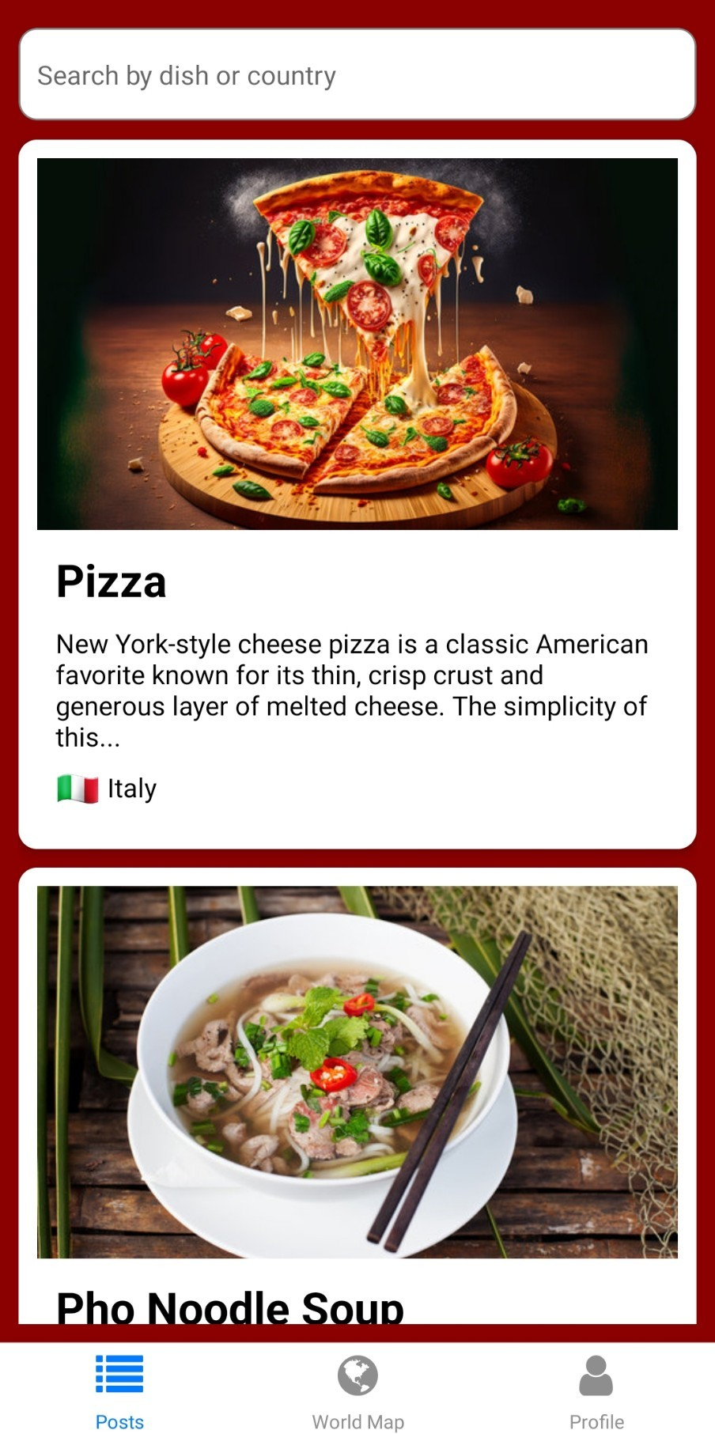
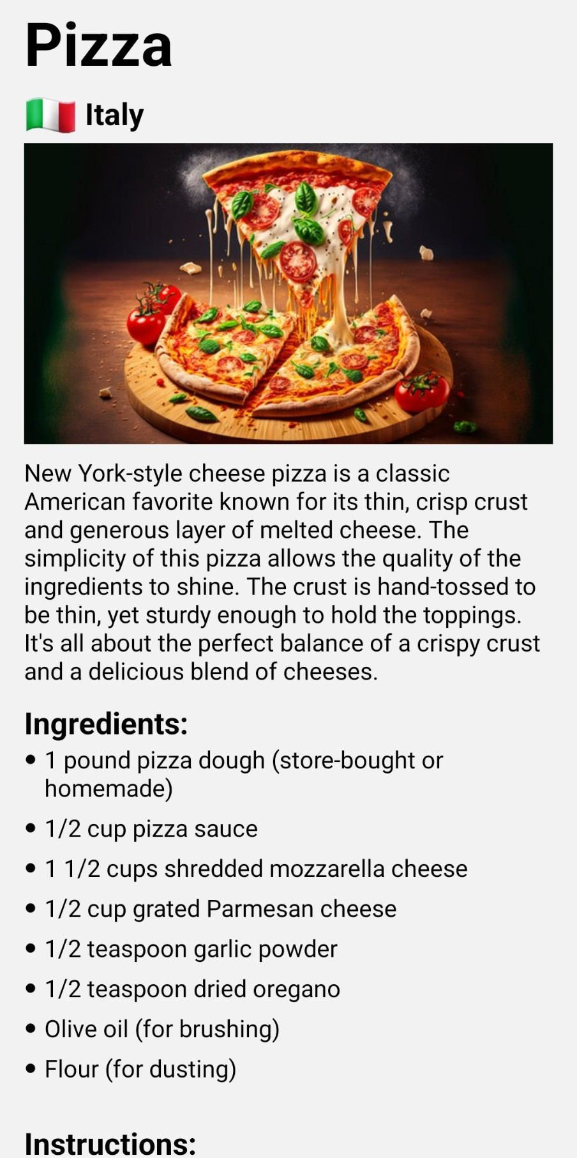
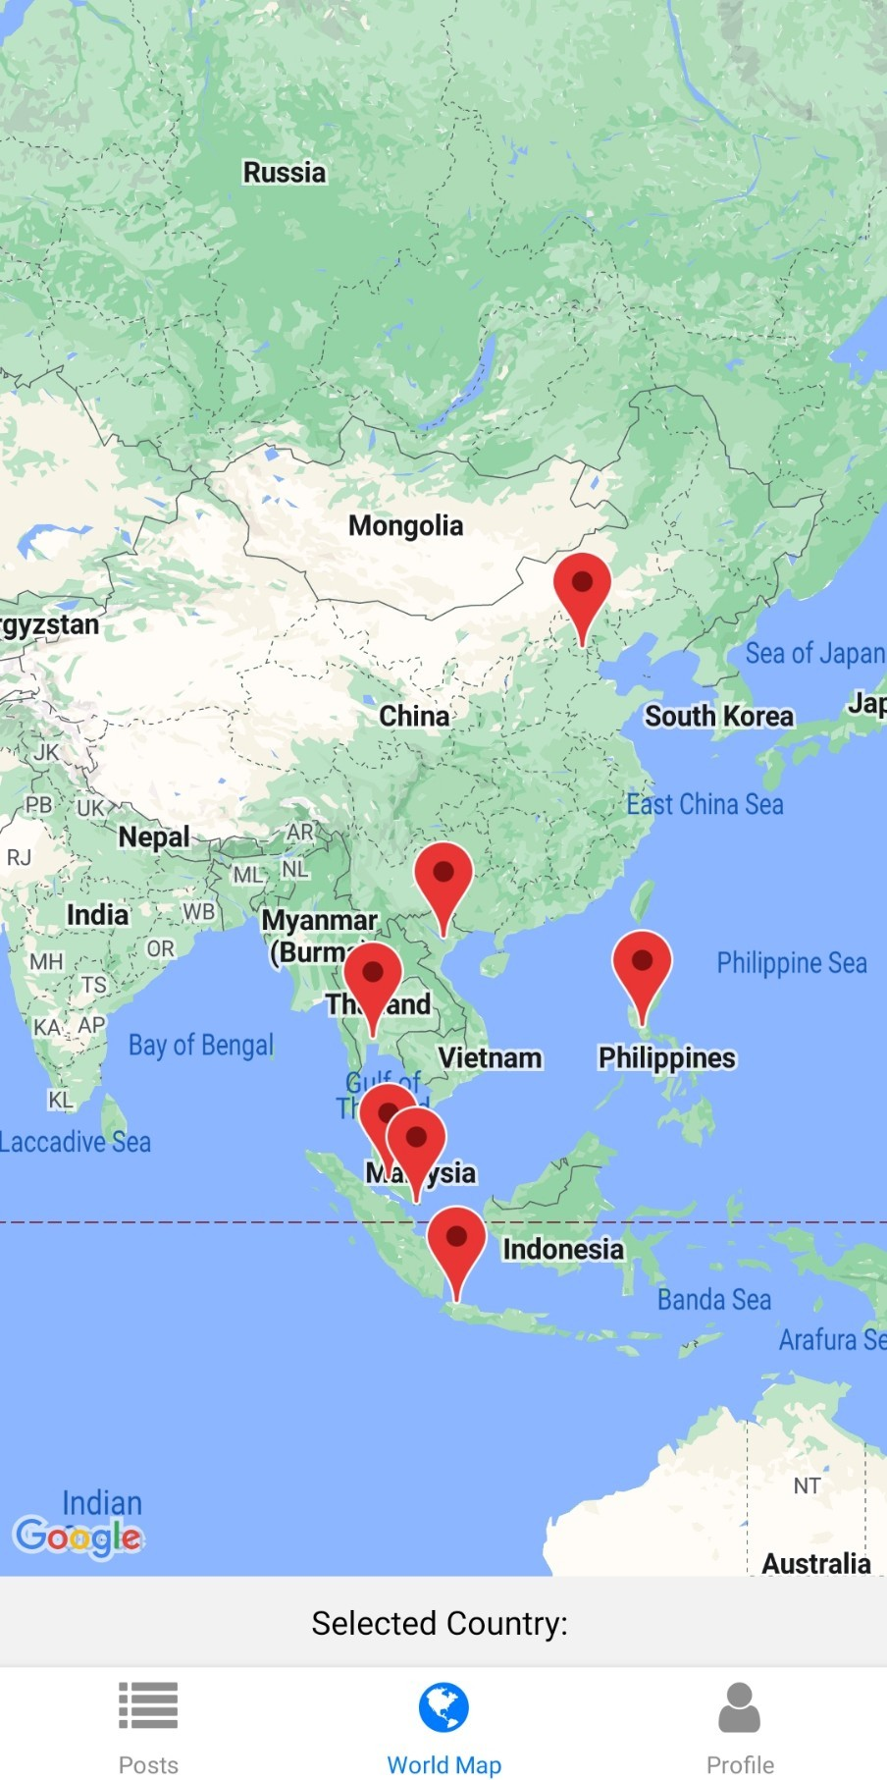
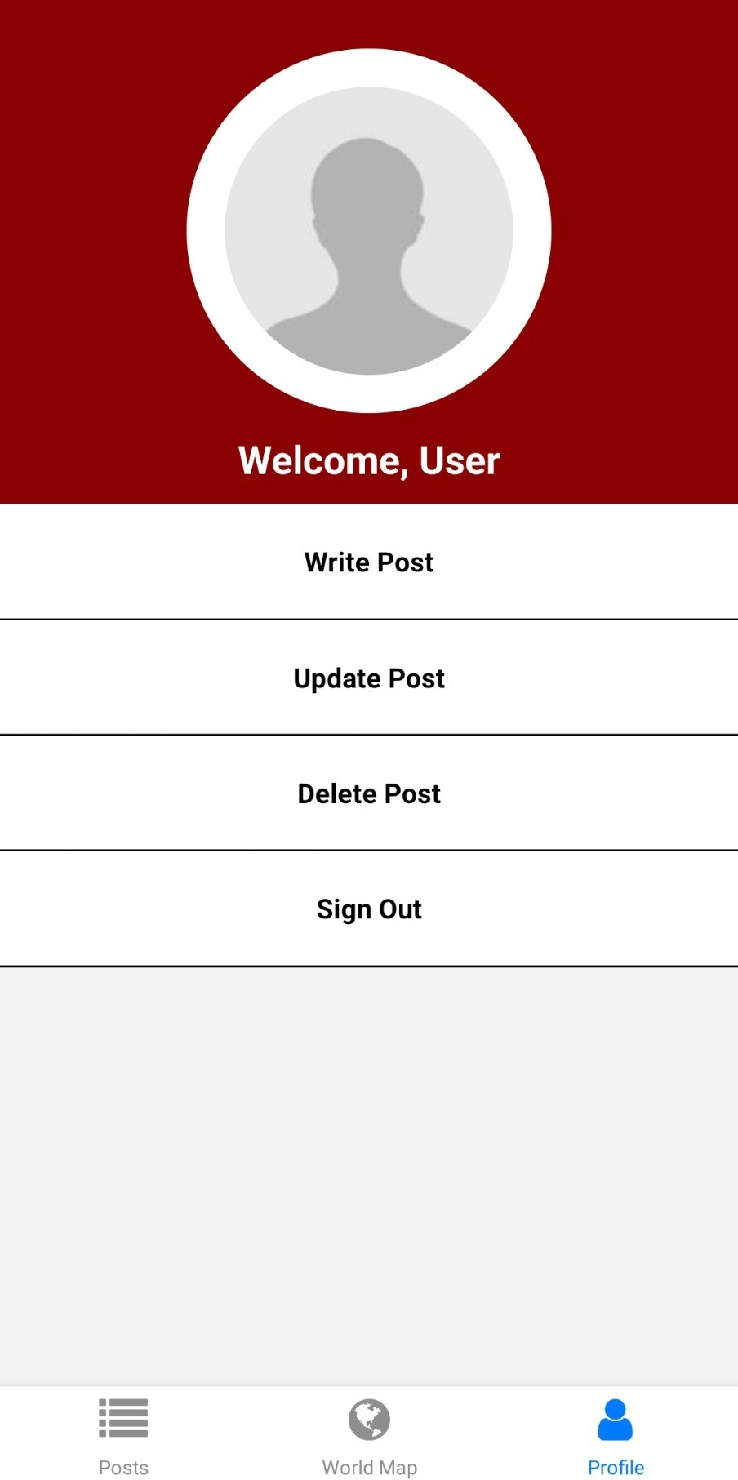
User interface

Slide 8




Language/software used

Slide 9

Flaws
UI still very simple
World map country selection not working
Can’t write article yet
Can’t edit or delete posts
Can’t change password or use the forgot password function

Slide 10

Future Update
Upgrade UI
Select country using markers on Google map
Write recipe article
Edit or delete posts
Favorite article
Ability to change password or use the forgot password function

Slide 11
THANK YOU FOR LISENING

